Slide 1
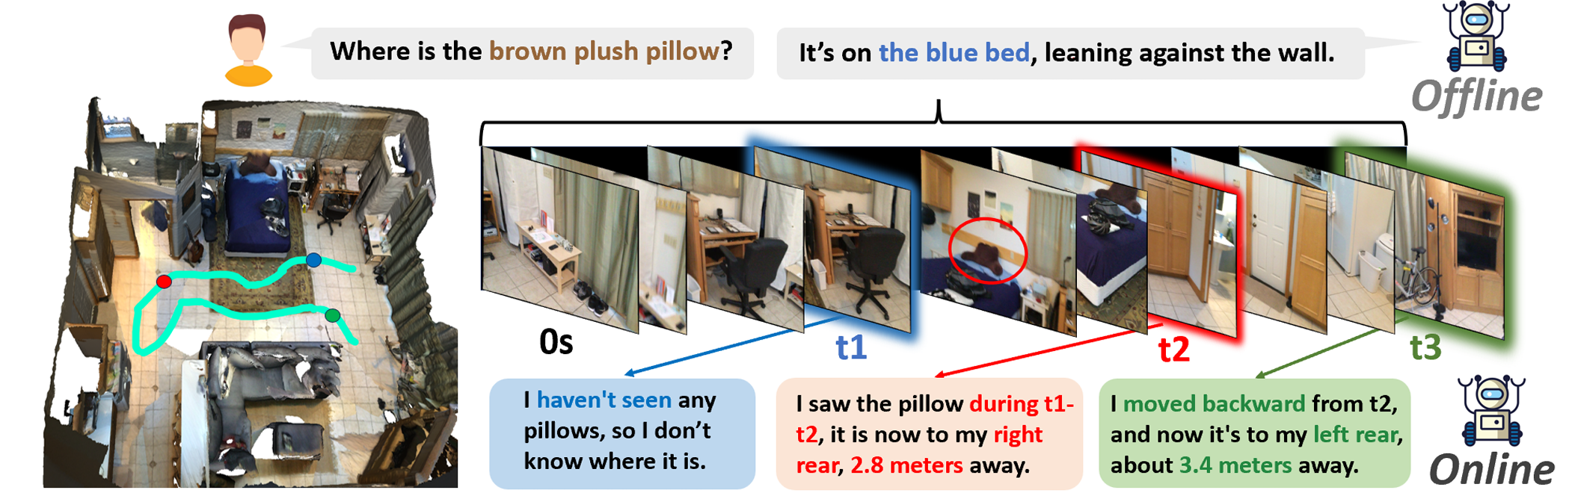
OST-Bench：在线时空场景理解基准测试
目前的空间推理基准都是从离线的设定出发，缺少对于在线理解的考察
OST-Bench要求模型在流式的观测输入下，基于当前状态以及历史观测，进行时空推理
“OST-Bench: Evaluating the Capabilities of MLLMs in Online Spatio-temporal Scene Understanding”. In Submission.

Slide 2
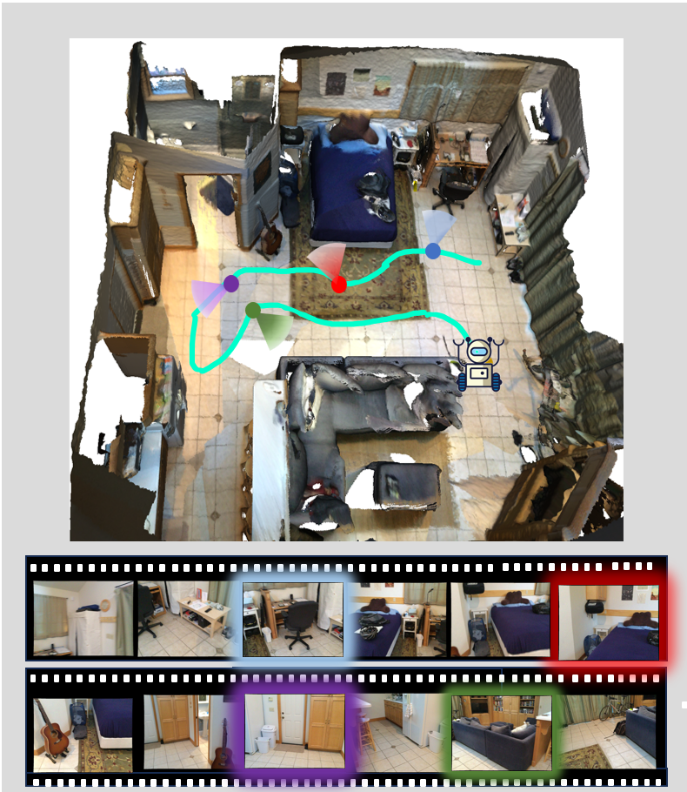

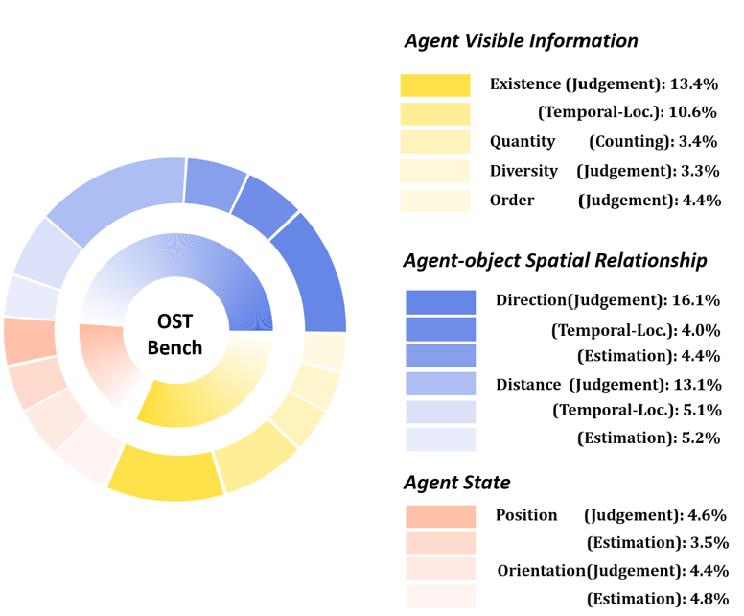


OST-Bench：在线时空场景理解基准测试
任务分类：智能体可见信息，自身状态，与物体空间关系
考察能力：判断，计数，估算，时间索引
Agent
State
Agent-Object
Spatial
Agent Visible Info
覆盖三种场景数据集的共计1.4k个场景，共计10k个问题，覆盖了15个子类
“OST-Bench: Evaluating the Capabilities of MLLMs in Online Spatio-temporal Scene Understanding”. In Submission.

Slide 3
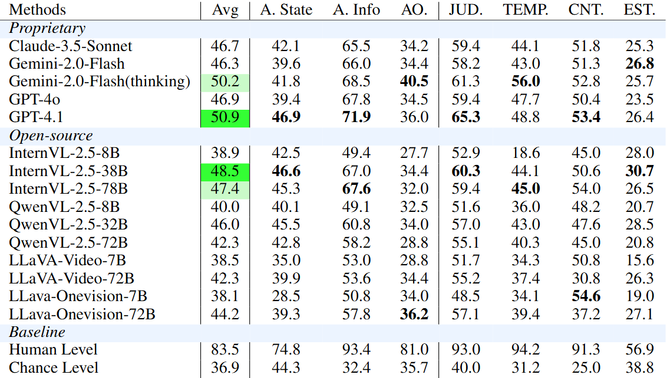
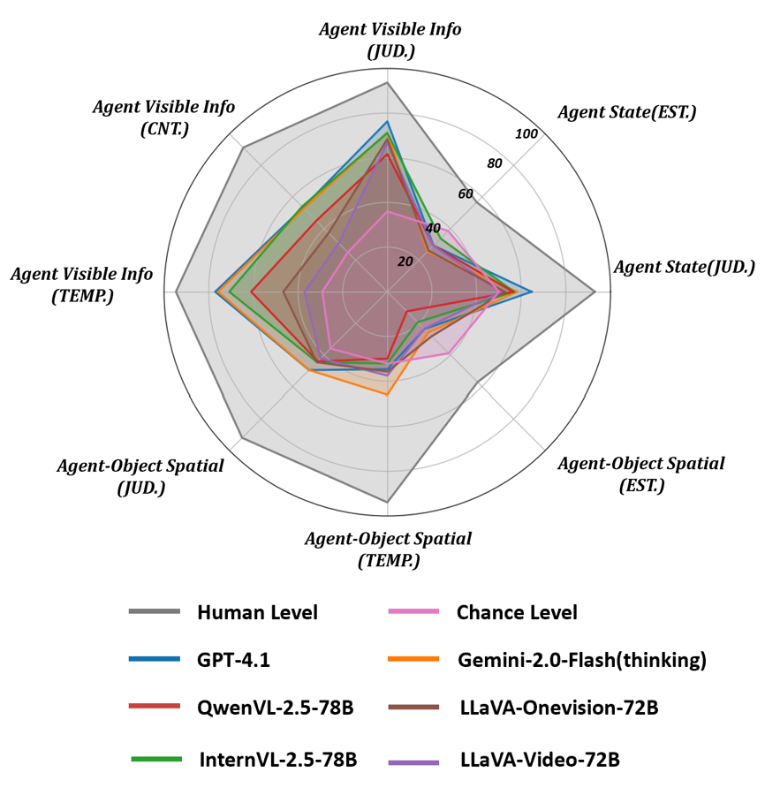
OST-Bench：在线时空场景理解基准测试
总体上MLLM与人类表现差距巨大
MLLM在纯时间推理问题表现良好，时空推理表现接近随机水平
闭源模型有明显优势，thinking模式时空推理有提升
开源模型参数量级增加主要提升的是时间推理能力
“OST-Bench: Evaluating the Capabilities of MLLMs in Online Spatio-temporal Scene Understanding”. In Submission.

Slide 4
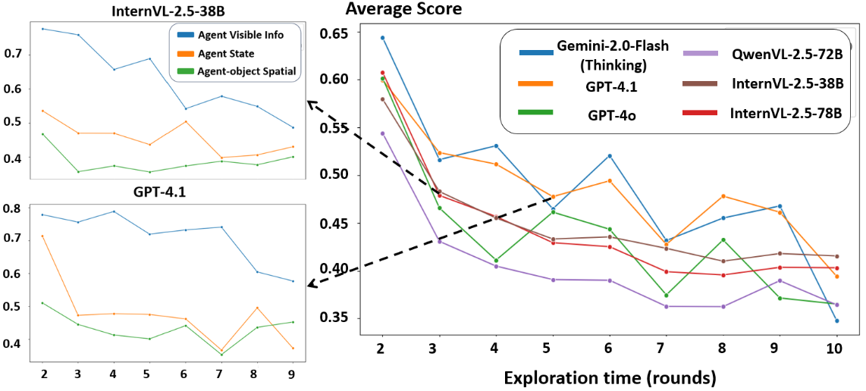
OST-Bench：在线时空场景理解基准测试
随着探索时间的增加，模型推理准确率下降规律
“OST-Bench: Evaluating the Capabilities of MLLMs in Online Spatio-temporal Scene Understanding”. In Submission.

Slide 5
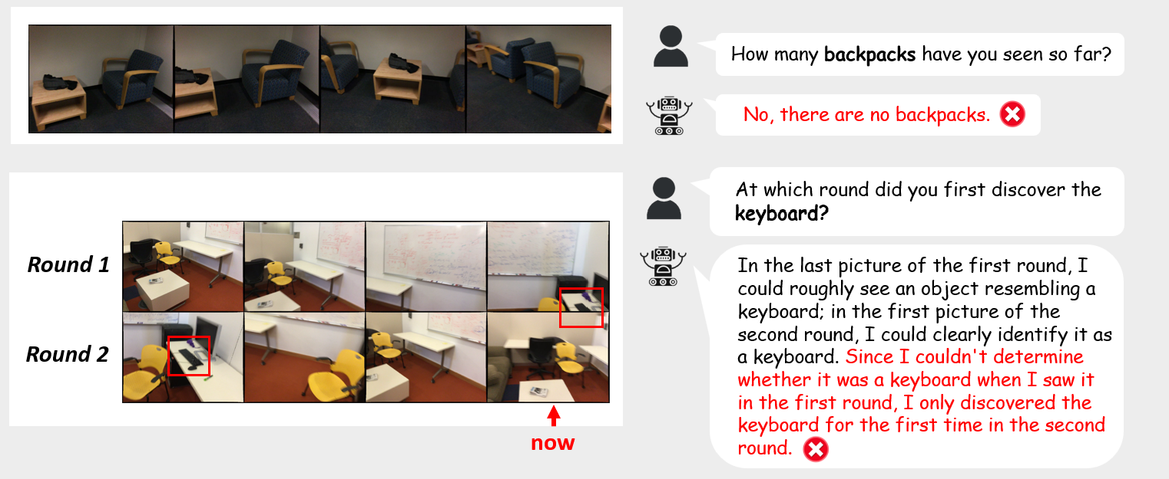
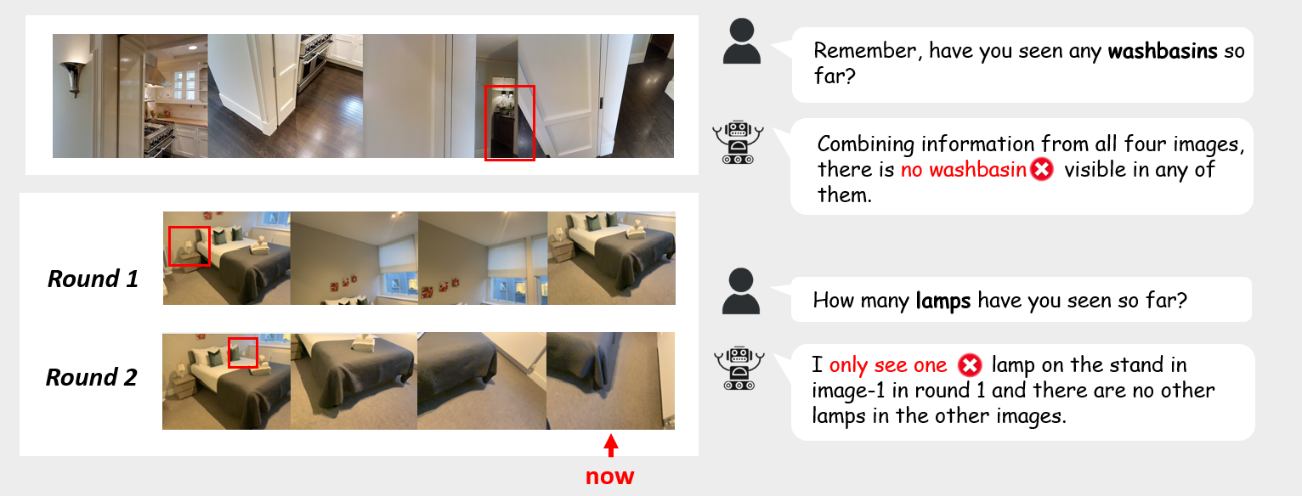
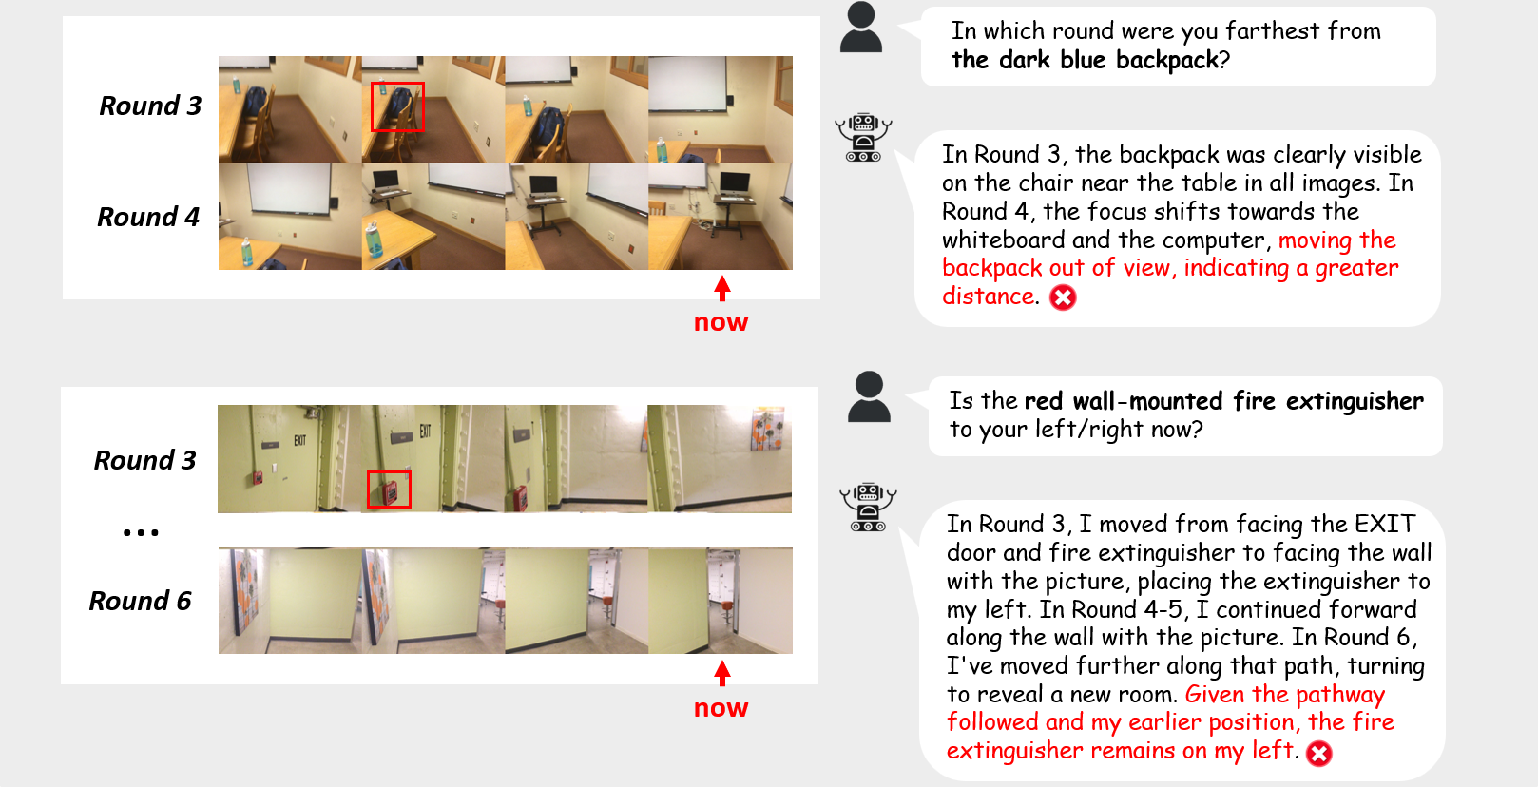
OST-Bench：在线时空场景理解基准测试
1. Prompt Analysis Error (指令分析错误)
3. Reasoning Error (推理错误)
2. Perception Error (感知错误)
“OST-Bench: Evaluating the Capabilities of MLLMs in Online Spatio-temporal Scene Understanding”. In Submission.

Slide 6
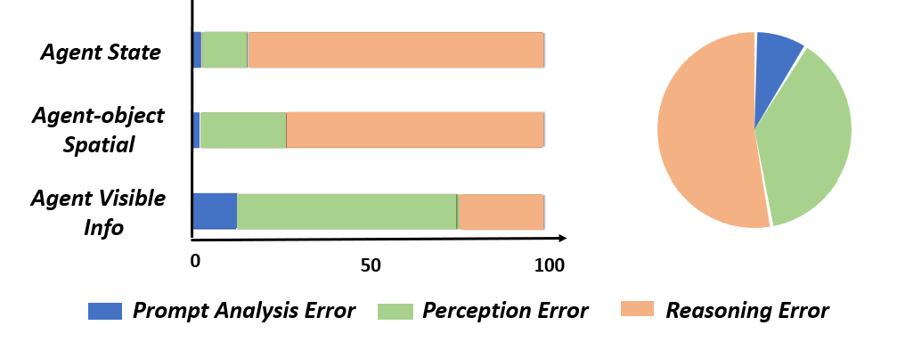
OST-Bench：在线时空场景理解基准测试
错误统计：主要是在推理步骤的错误，特别是涉及时空推理时
“OST-Bench: Evaluating the Capabilities of MLLMs in Online Spatio-temporal Scene Understanding”. In Submission.

Slide 7
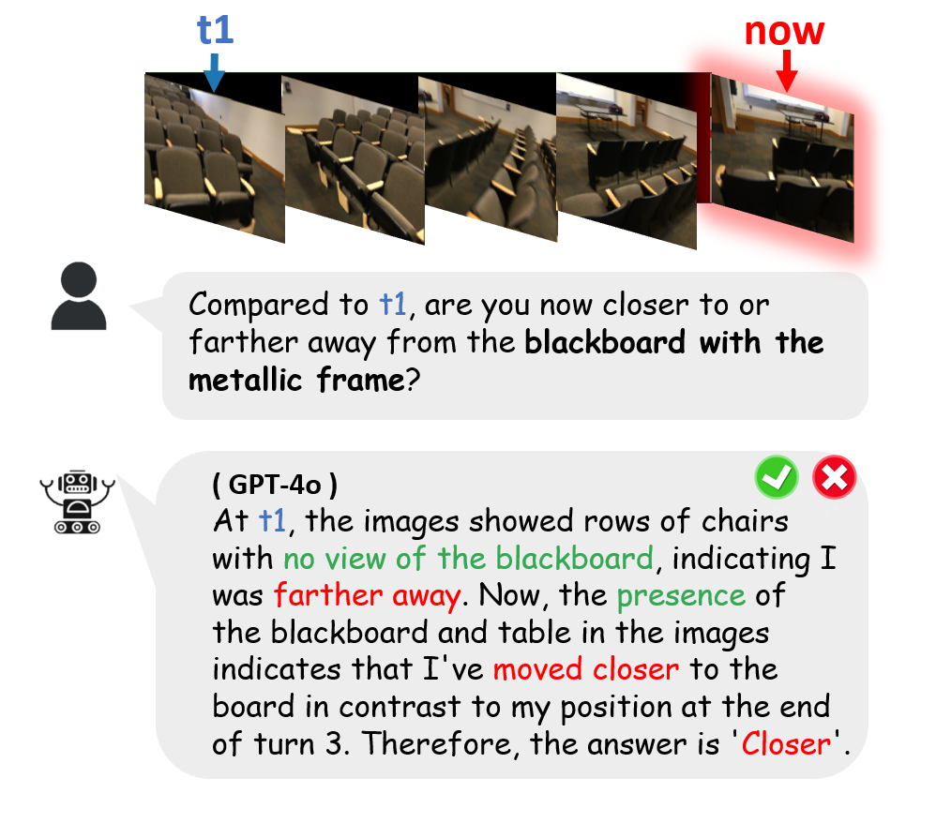
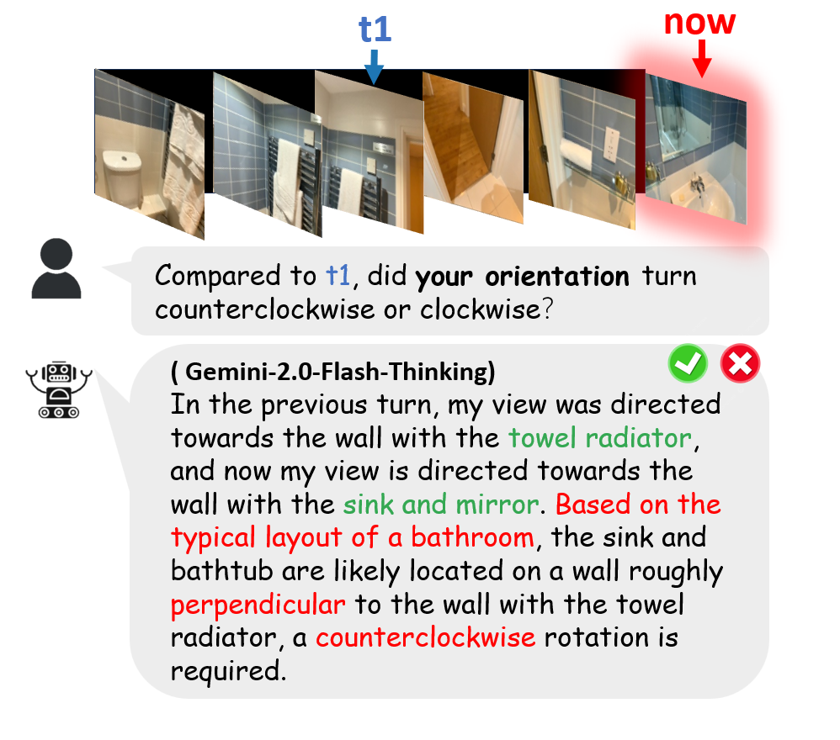
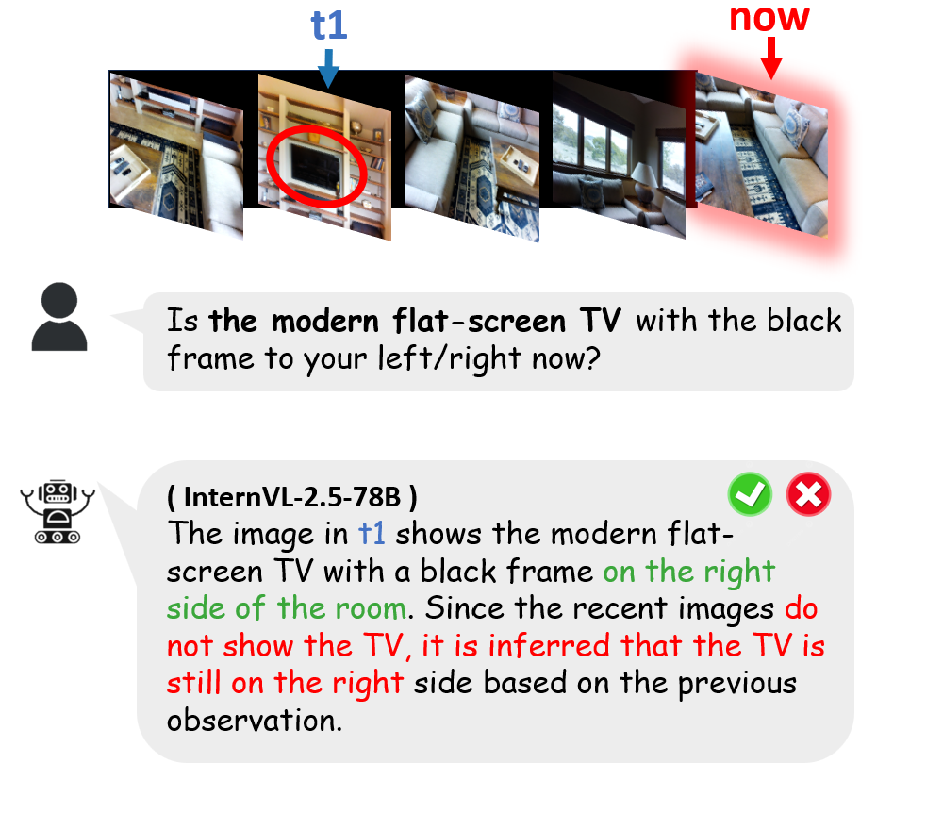
OST-Bench：在线时空场景理解基准测试
错误统计：模型在时空推理时的常见现象，3D推理捷径
“OST-Bench: Evaluating the Capabilities of MLLMs in Online Spatio-temporal Scene Understanding”. In Submission.

Slide 8
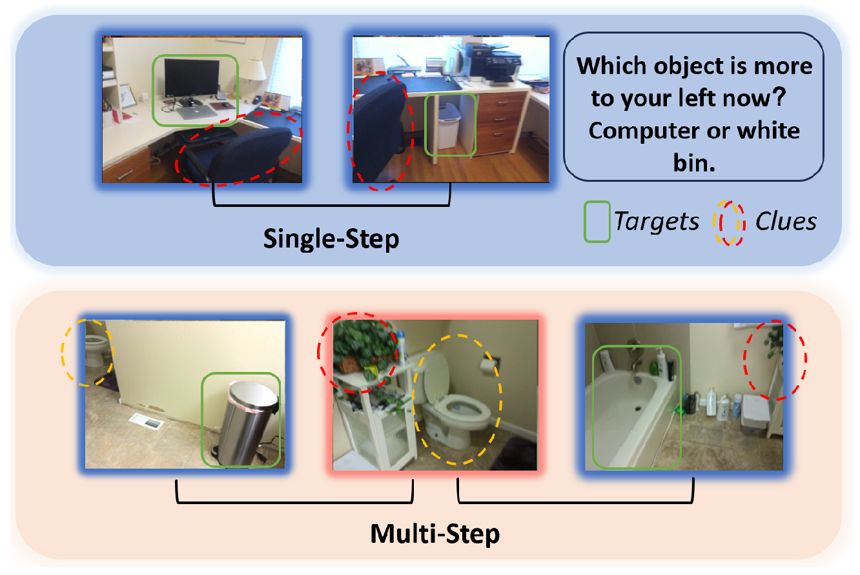
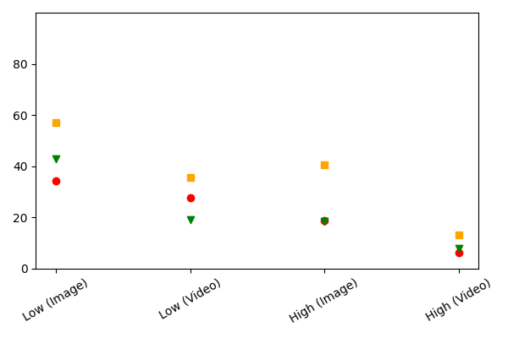

OST-Bench：在线时空场景理解基准测试
设计Subset分不同难度层级问题探究模型能力边界
Single
(keyframe)
Single
(Sequence)
Multi
(keyframe)
Multi
(Sequence)
(1) 从单步到需要多部推理的问题模型性能下降显著
(2) 是否直接提供关键帧对于模型性能影响大
阻碍模型表现的是两方面能力的短板，复杂的推理能力 & 长时序定位关键帧的能力
“OST-Bench: Evaluating the Capabilities of MLLMs in Online Spatio-temporal Scene Understanding”. In Submission.

